Slide 1
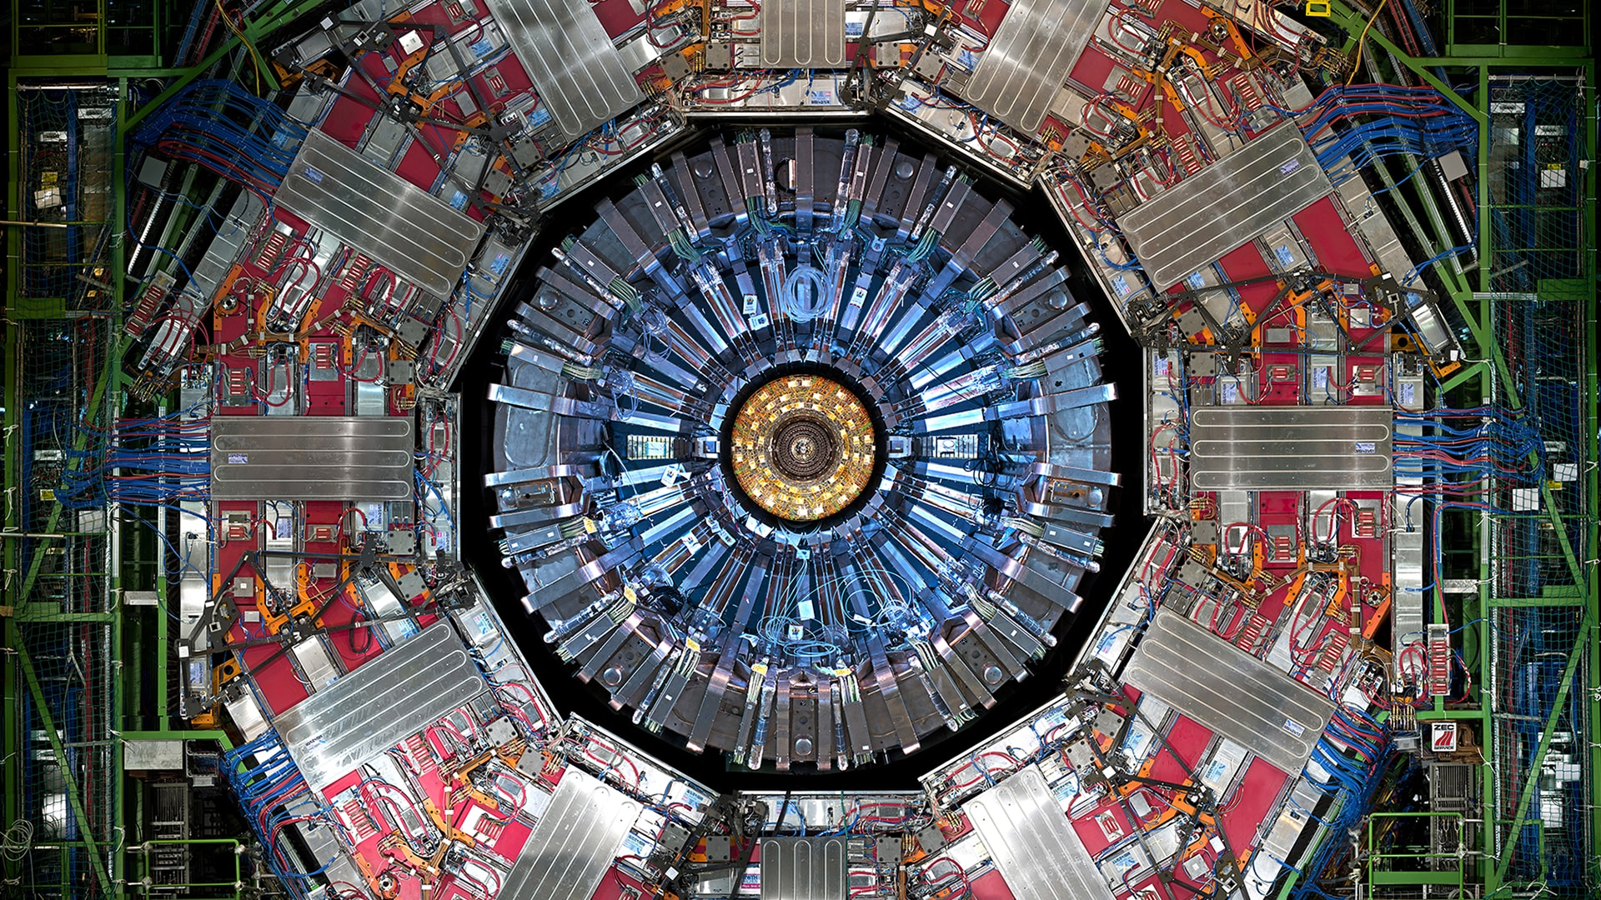
Chapter 4. Interactions as a exchange of particles

Slide 2
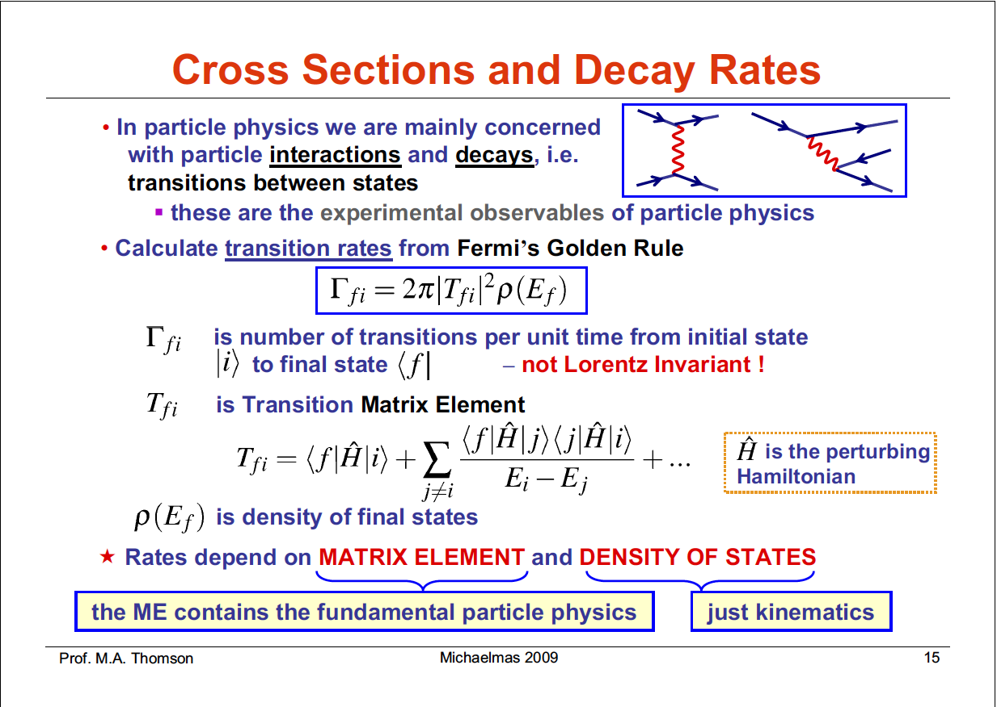

Slide 3
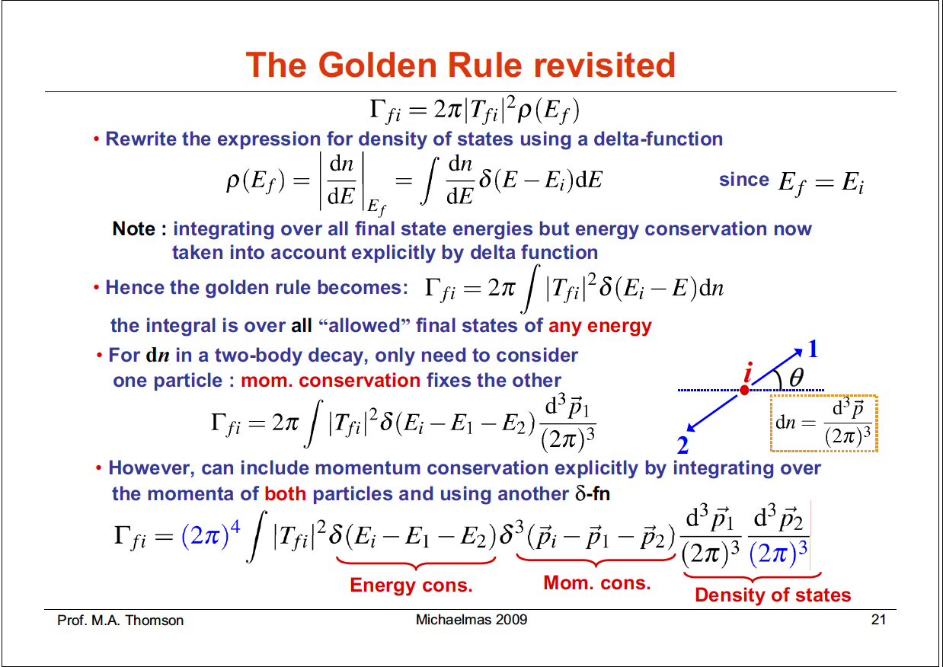

Slide 4
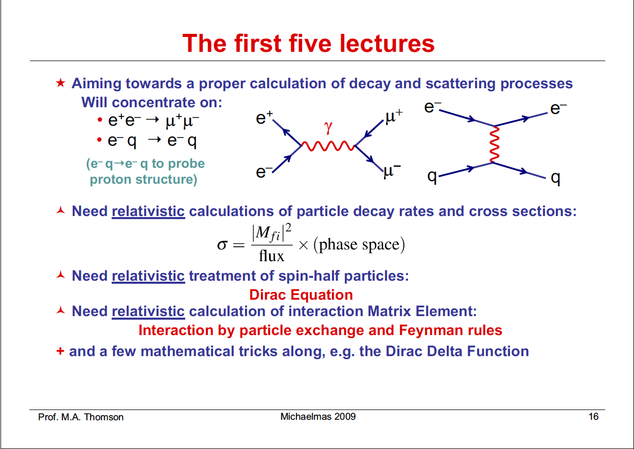

Slide 5
number of states
The density of states corresponds to the number of momentum states
accessible to a particular decay
The number of states increases with the momentum of the final-state particles
The decay to lighter particles, which will be produced with larger momentum,
are favored over decays to heavier particles

Slide 6
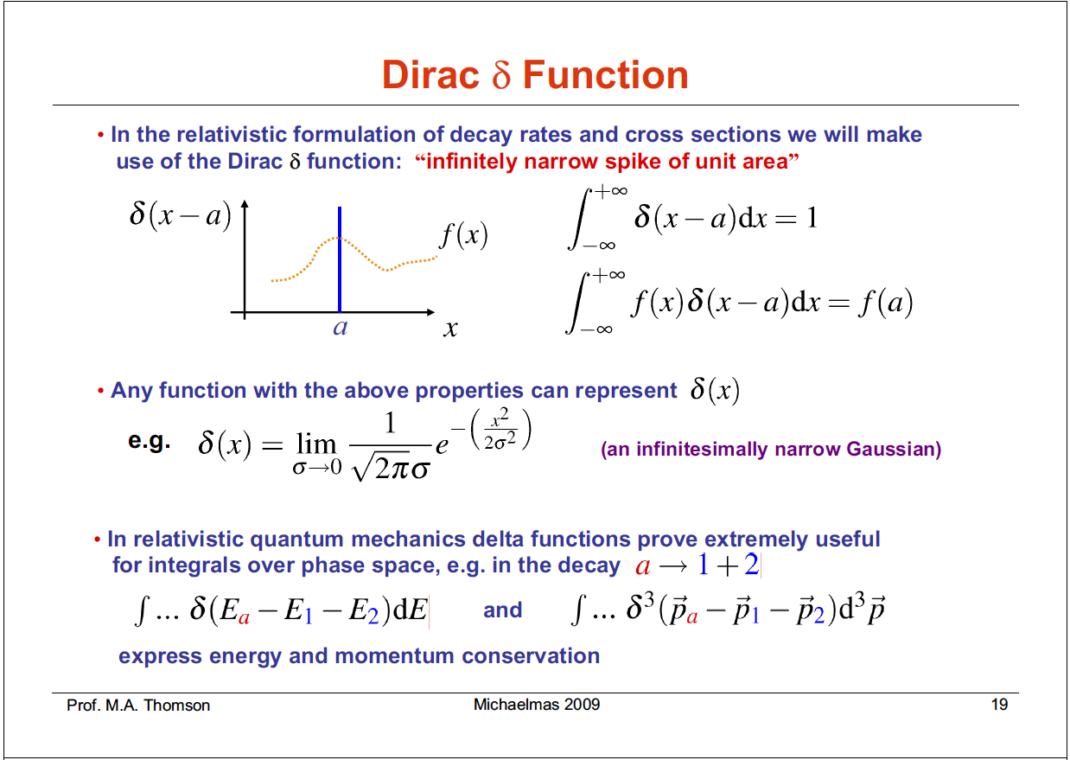

Slide 7
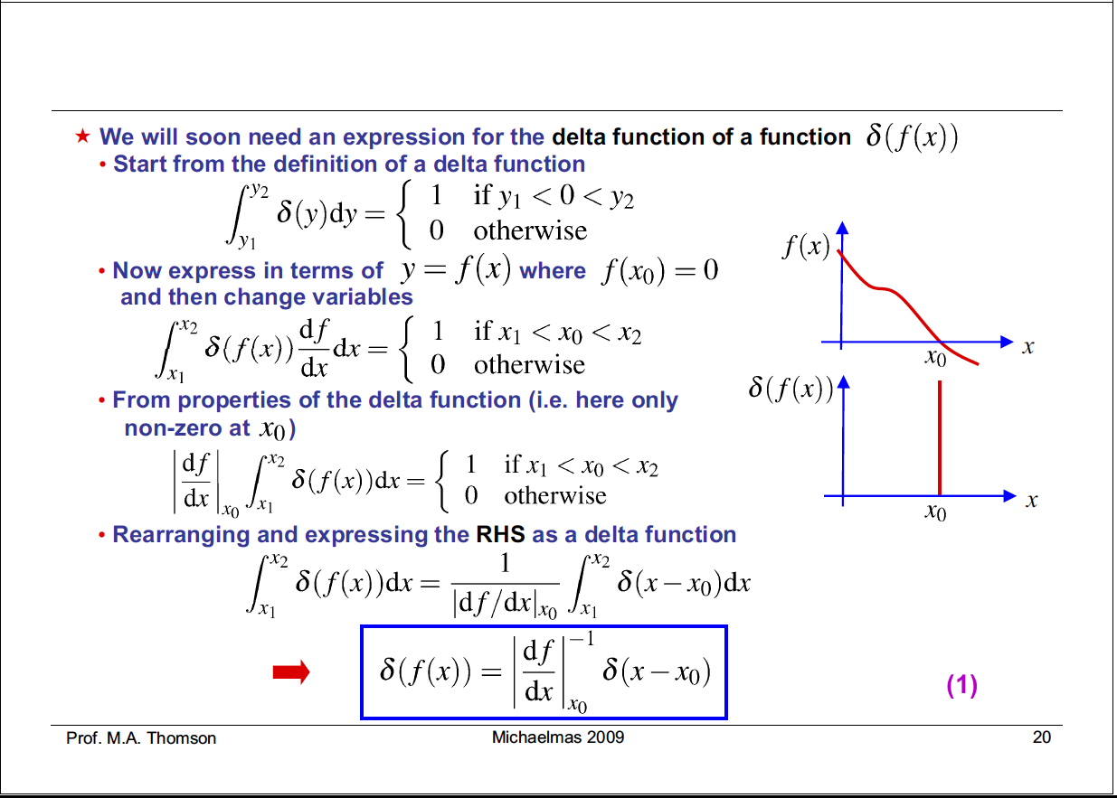

Slide 8
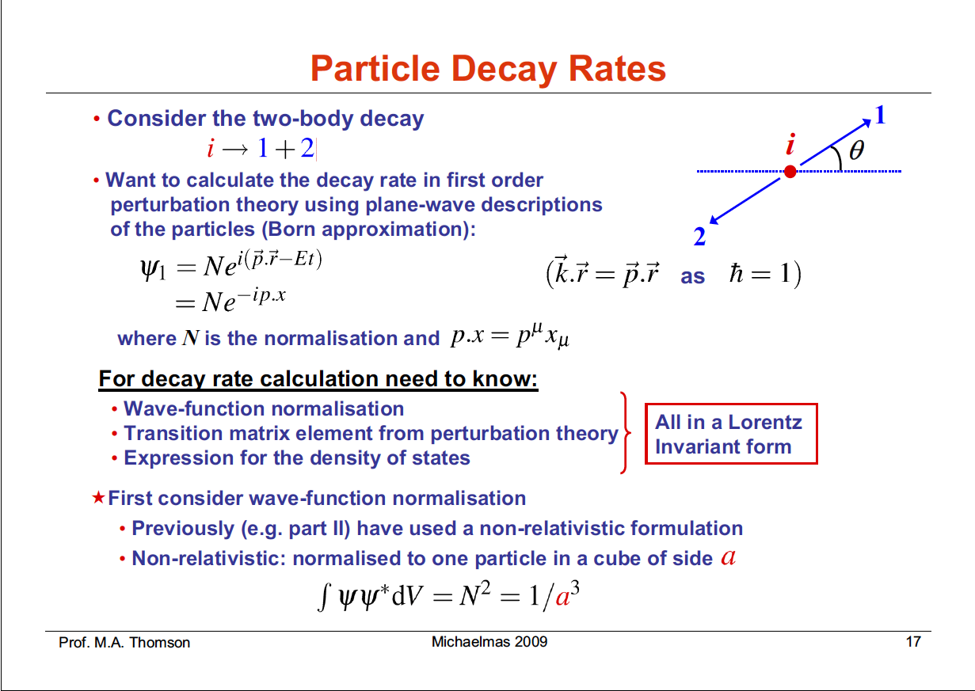

Slide 9
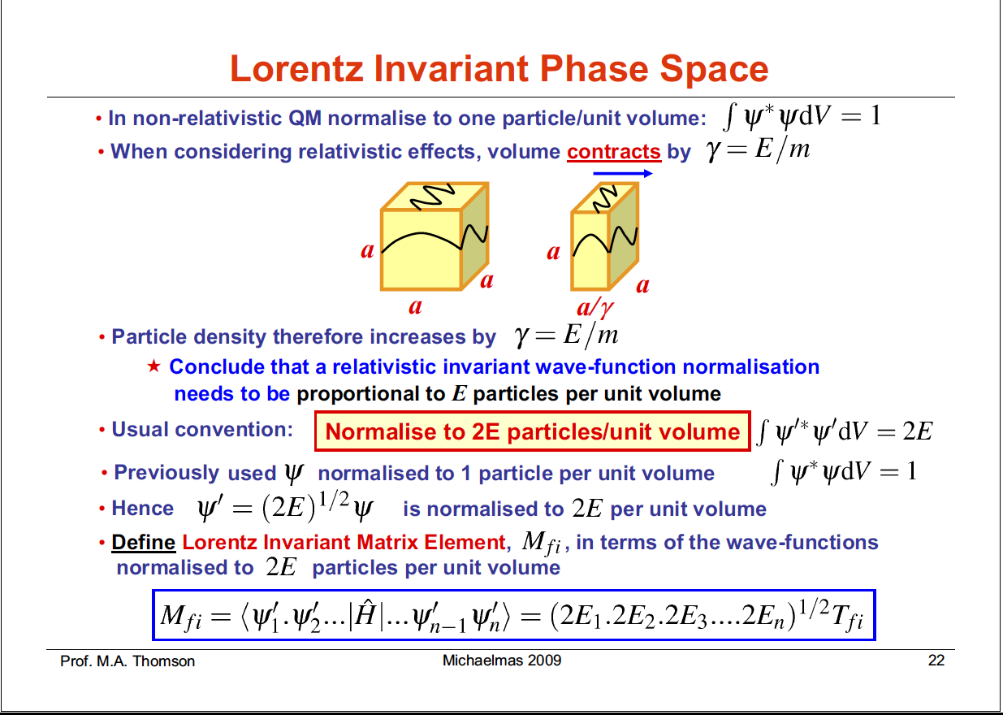

Slide 10

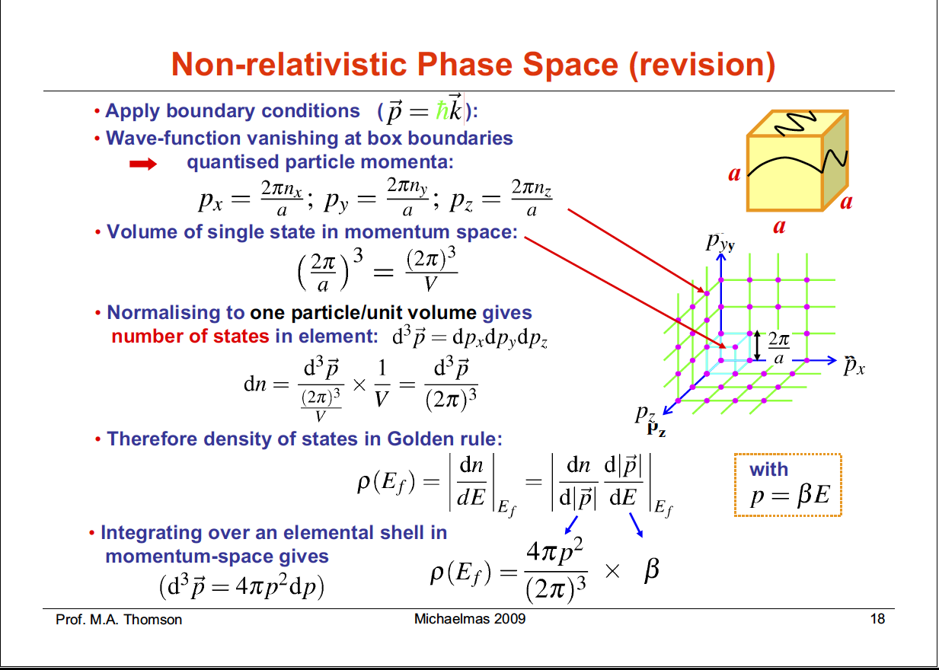
= 1 / V
ψ(x+a,y,z) = ψ(x,y,z)
e^{ipx} = e ^{ip(x+a)}
⬅ pa = 2π
d³p = dp_{x}dp_{y}dp_{z}
Average volume
of a single state
Number of states between E and E+dE:

Slide 12
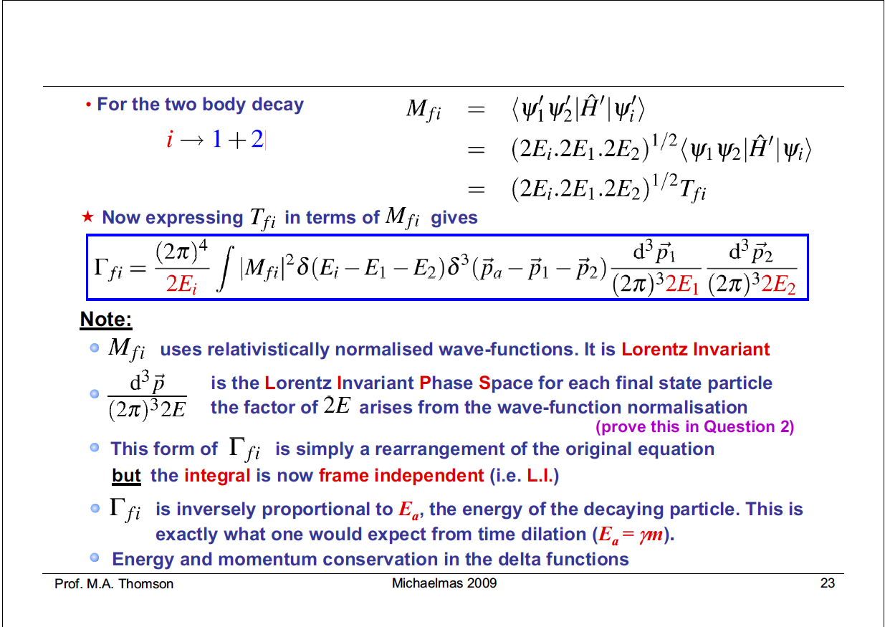

Slide 13
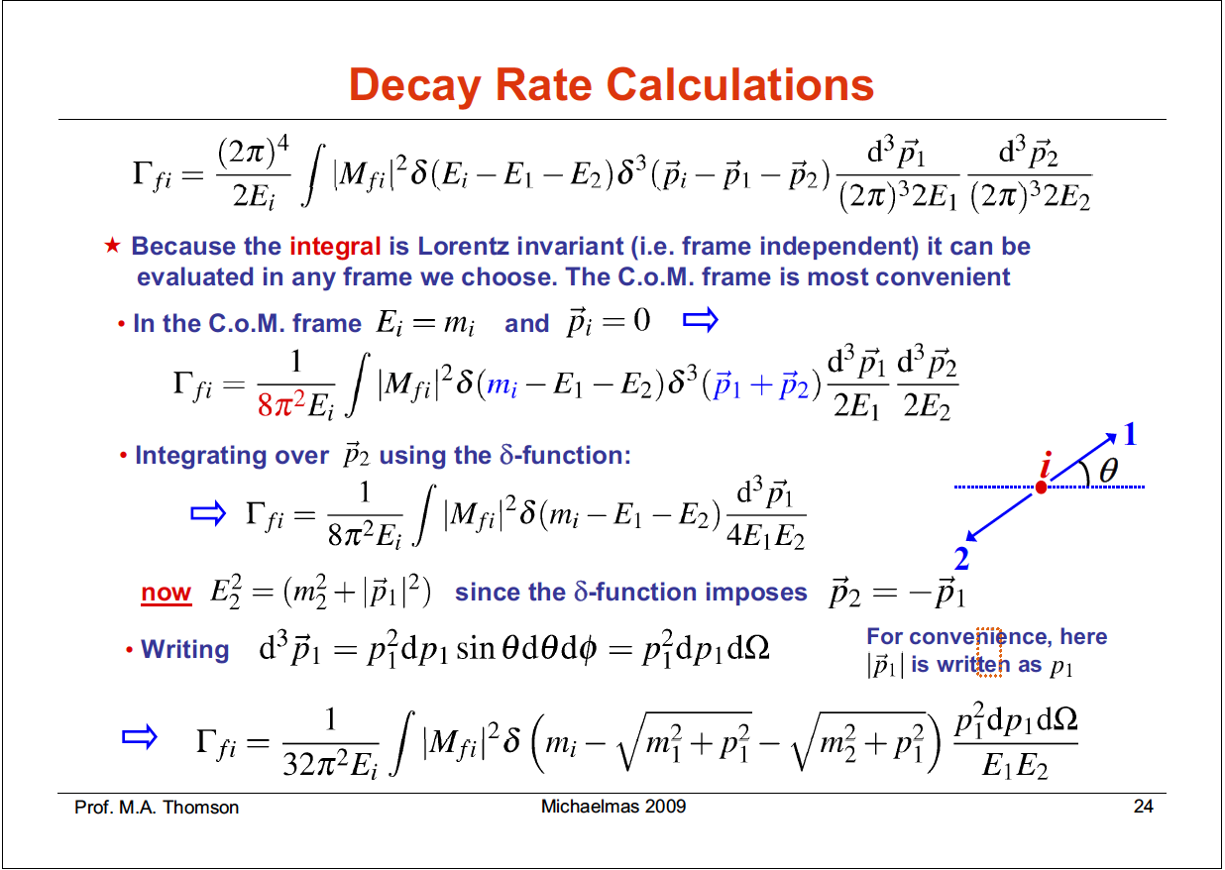

Slide 14
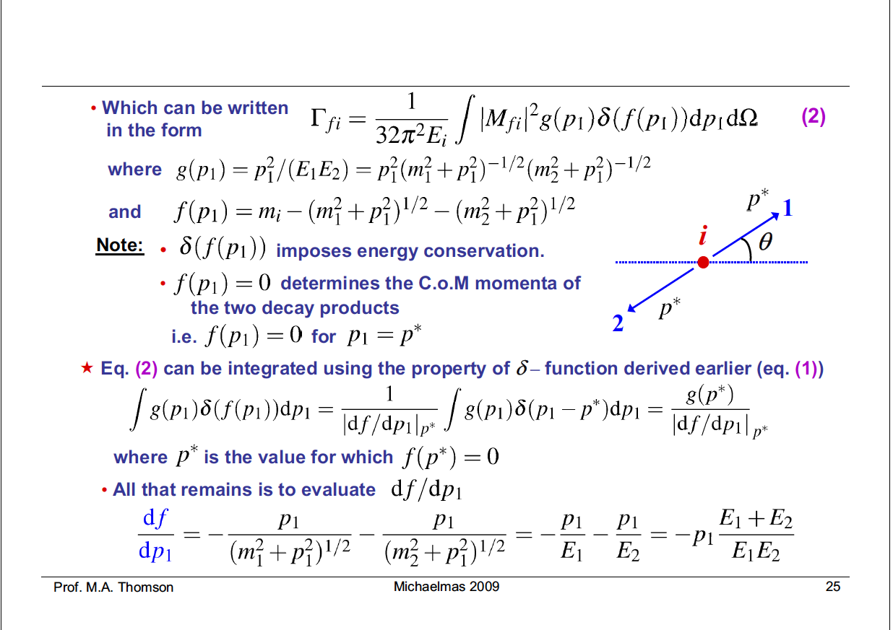

Slide 15
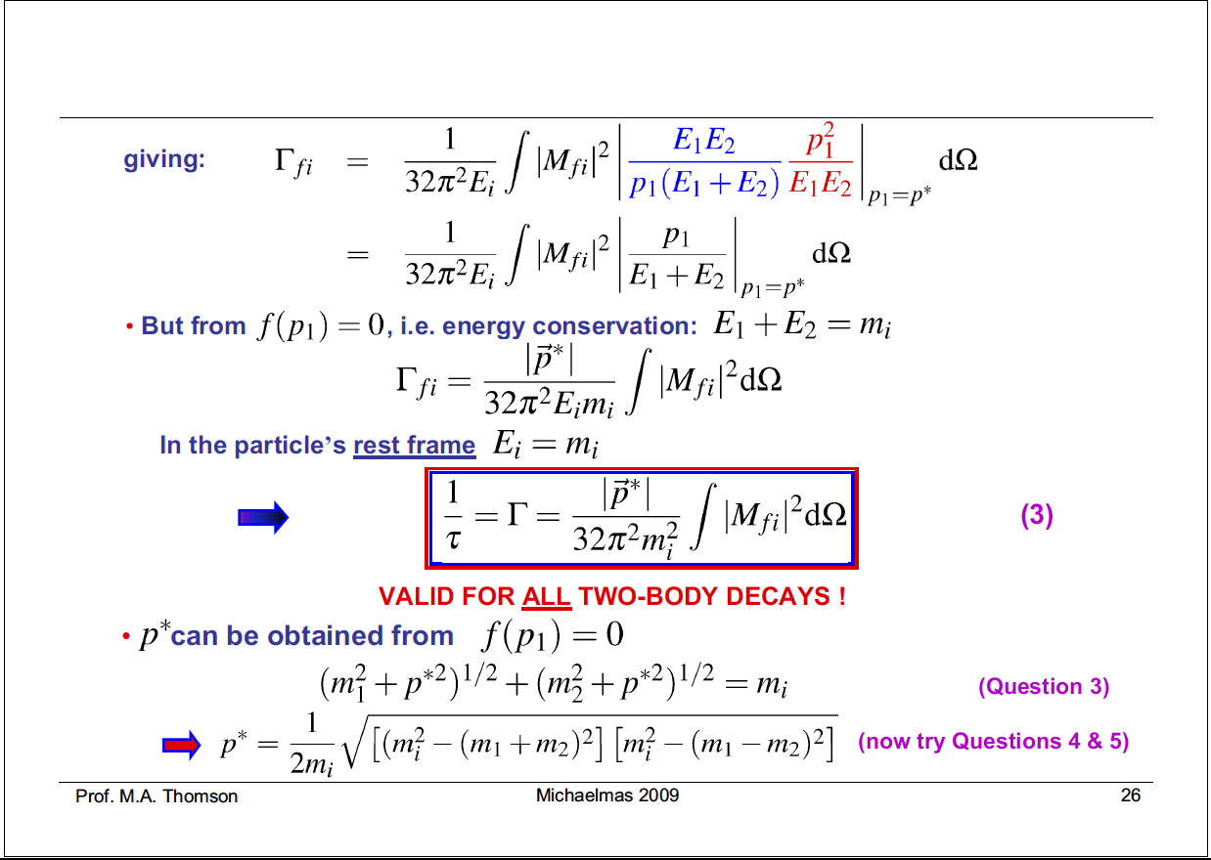

Slide 16
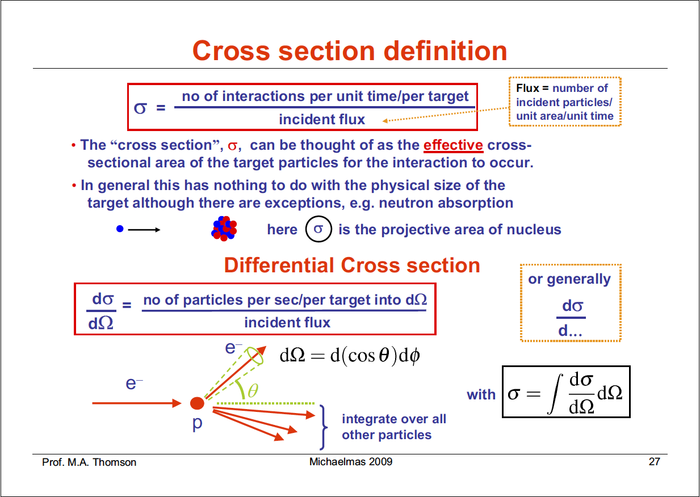
In general this has nothing to do with the physical size of the target.
It is the underlying quantum probability that an interaction will occur.

Slide 17
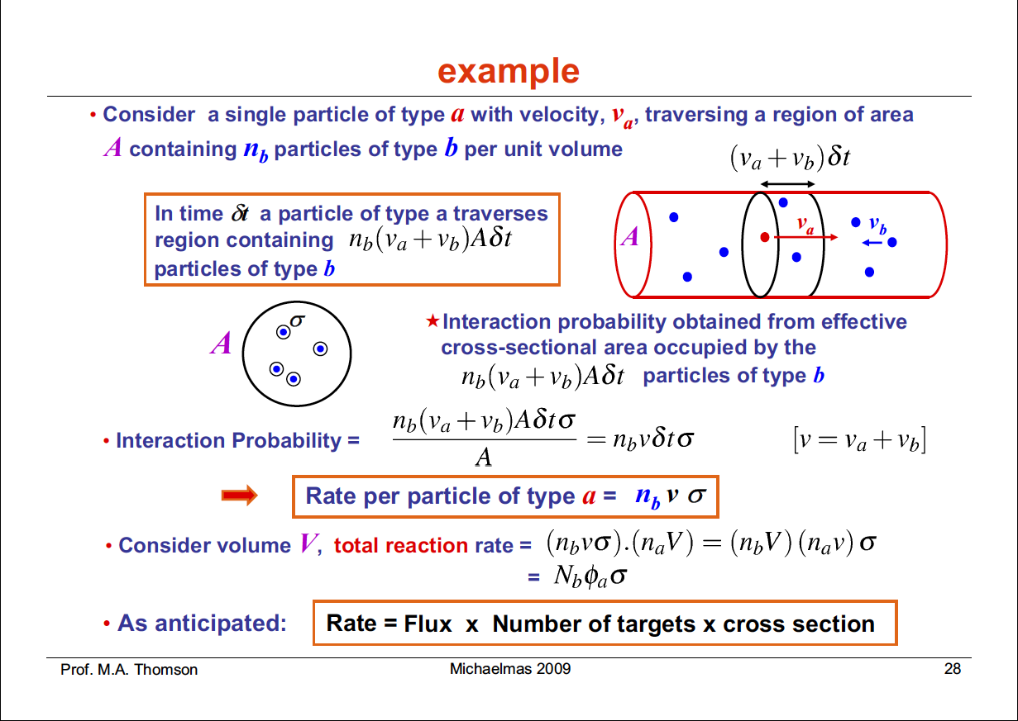
= δN
δP = (δN σ) / A
Rate = δP / δt

Slide 18
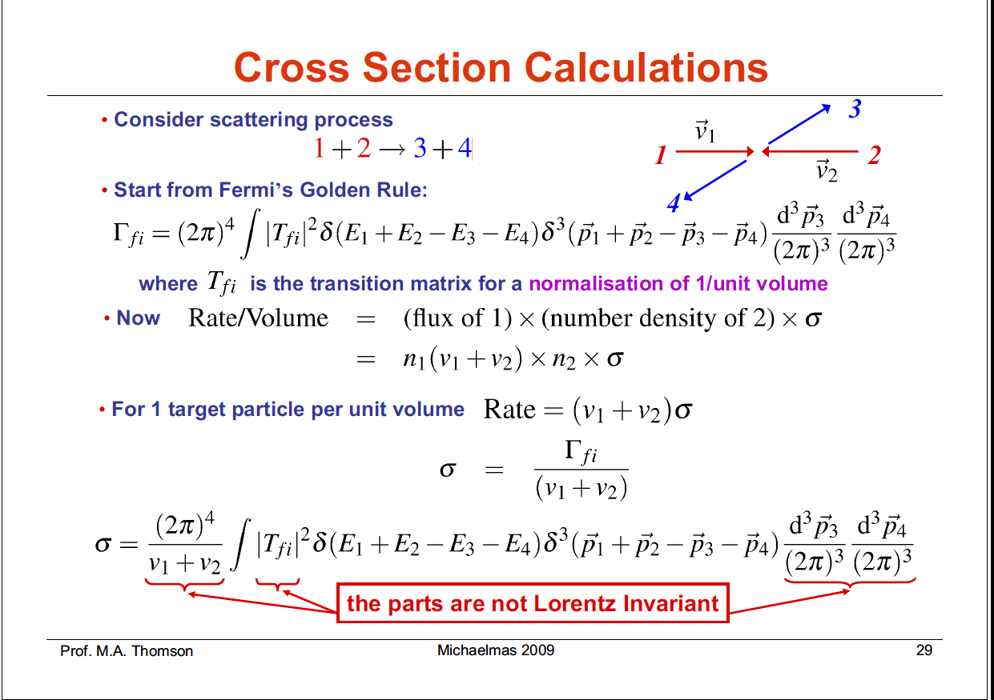
n₁ = n₂ = 1/V
(V = 1)

Slide 19
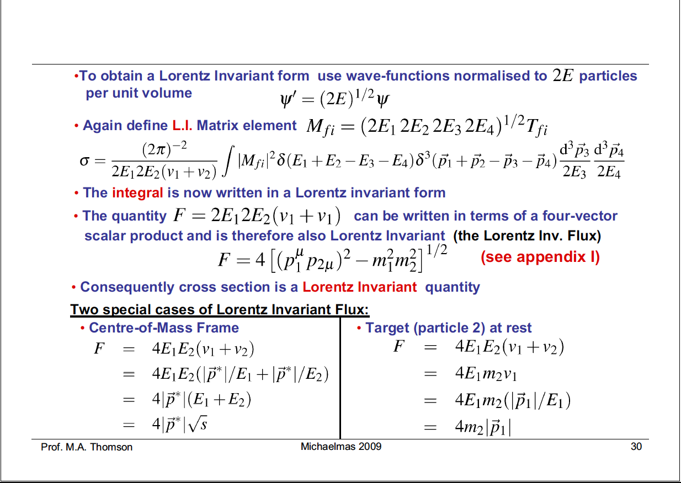

Slide 20
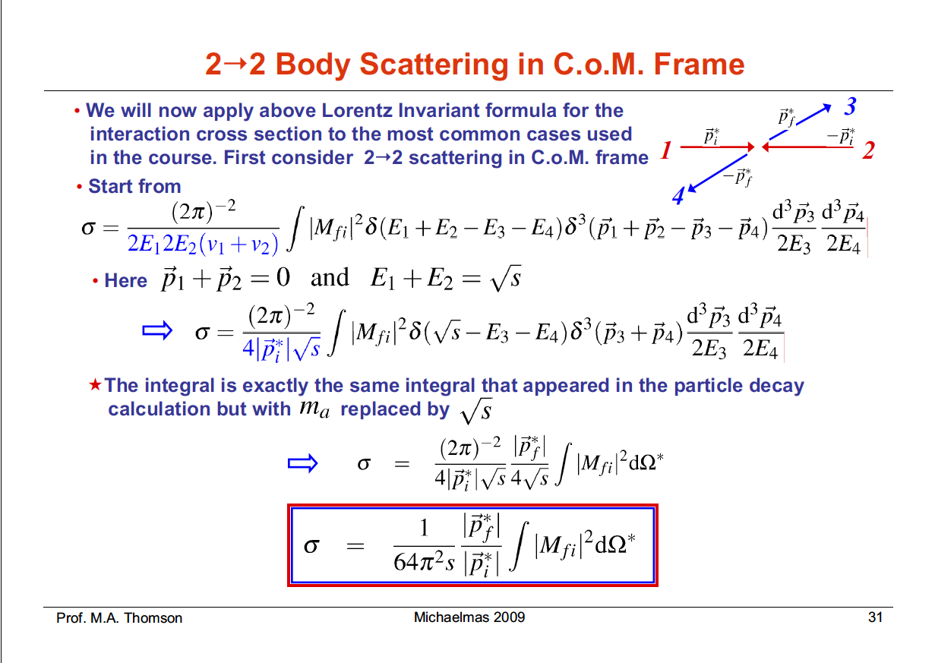

Slide 21
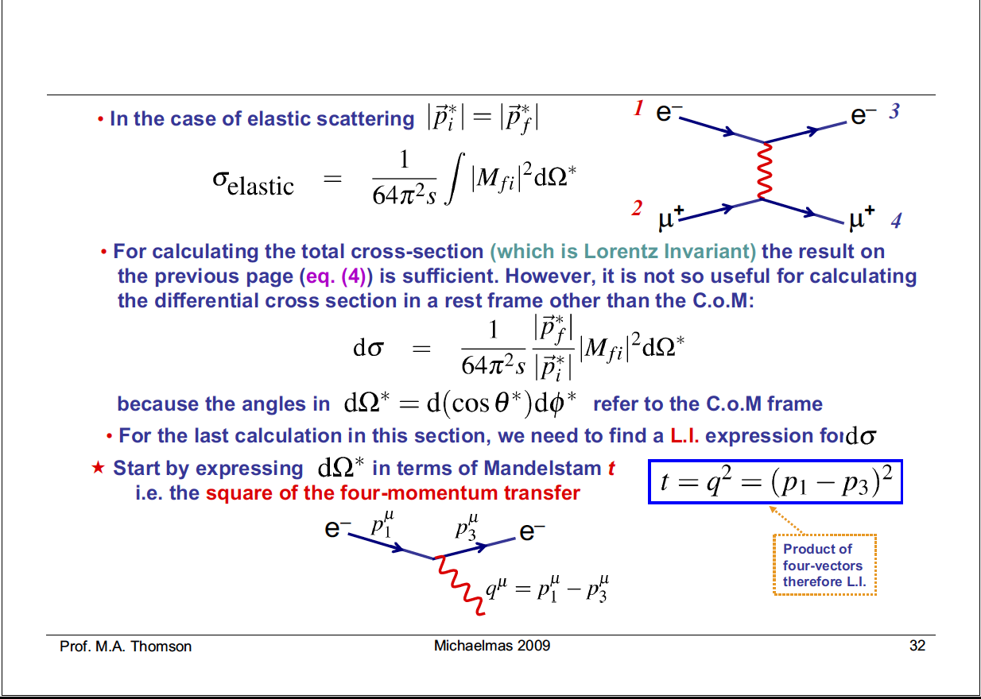

Slide 22
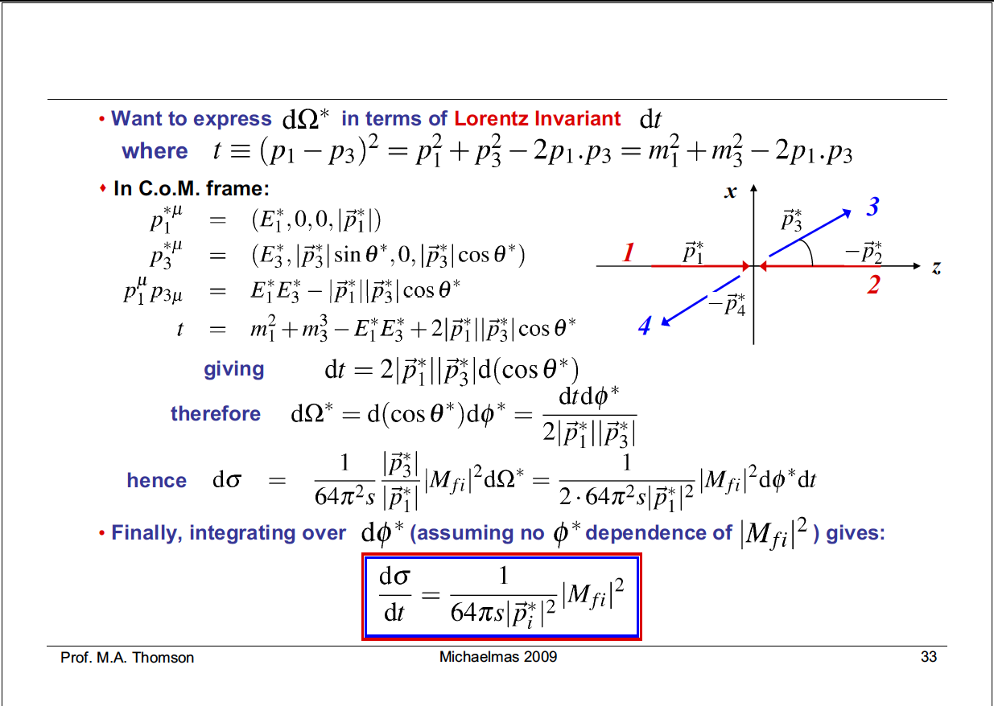

Slide 23
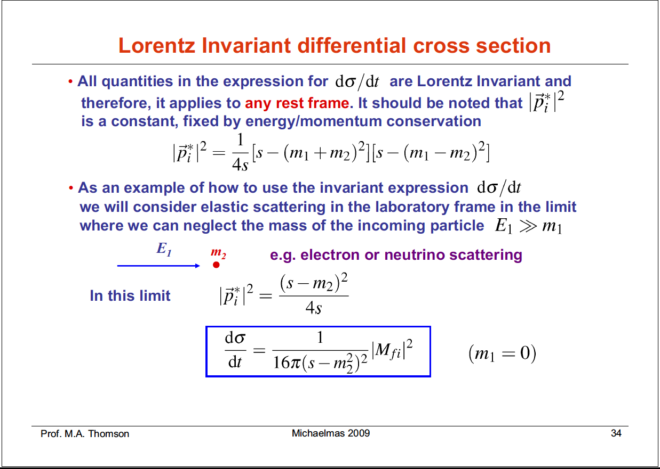
1
2

Slide 24
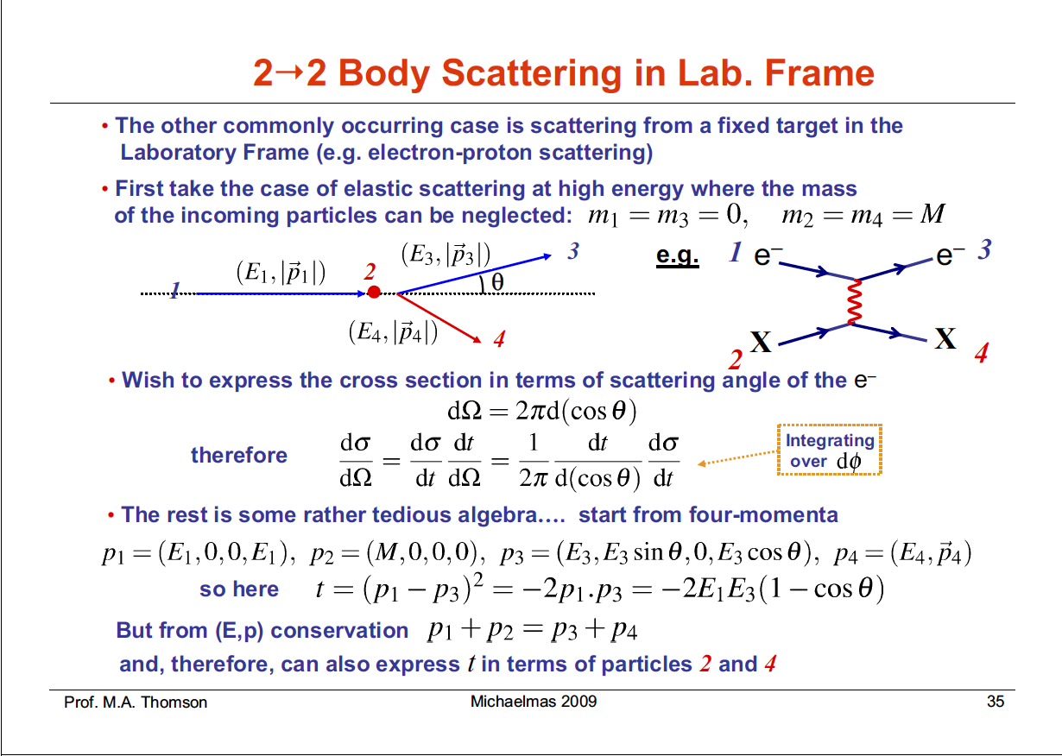
2

Slide 25
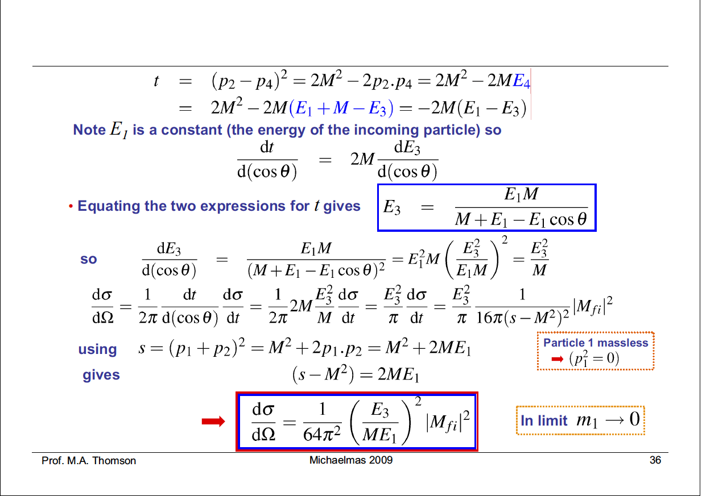
2
(E₁M)²

Slide 26
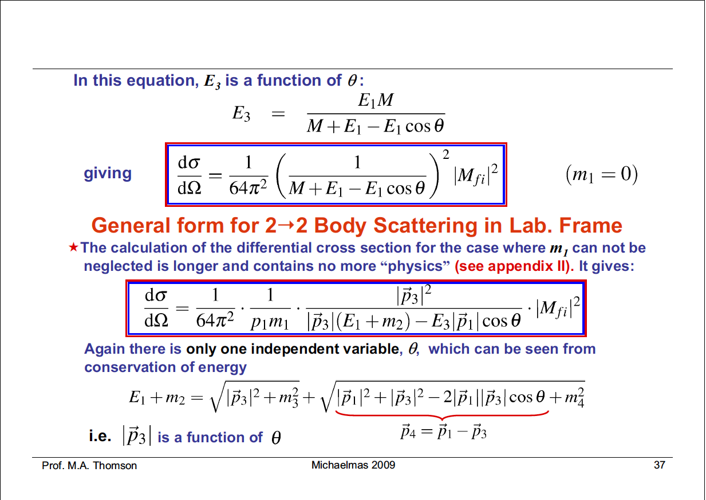

Slide 27
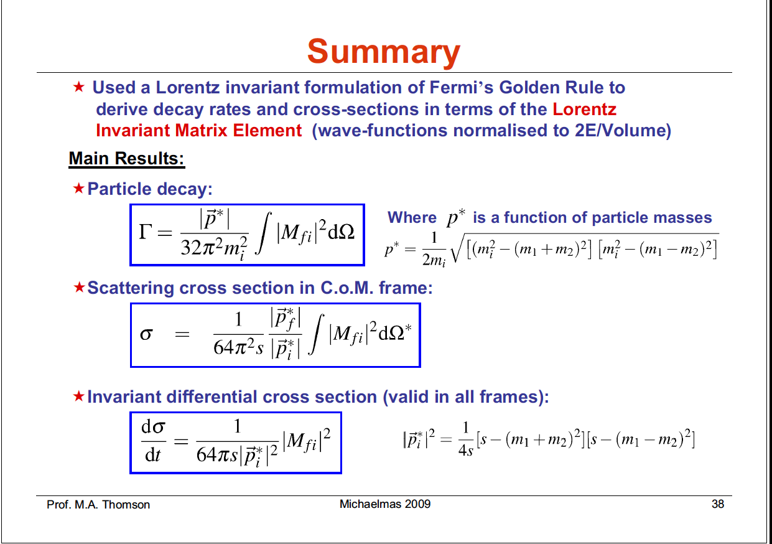

Slide 28
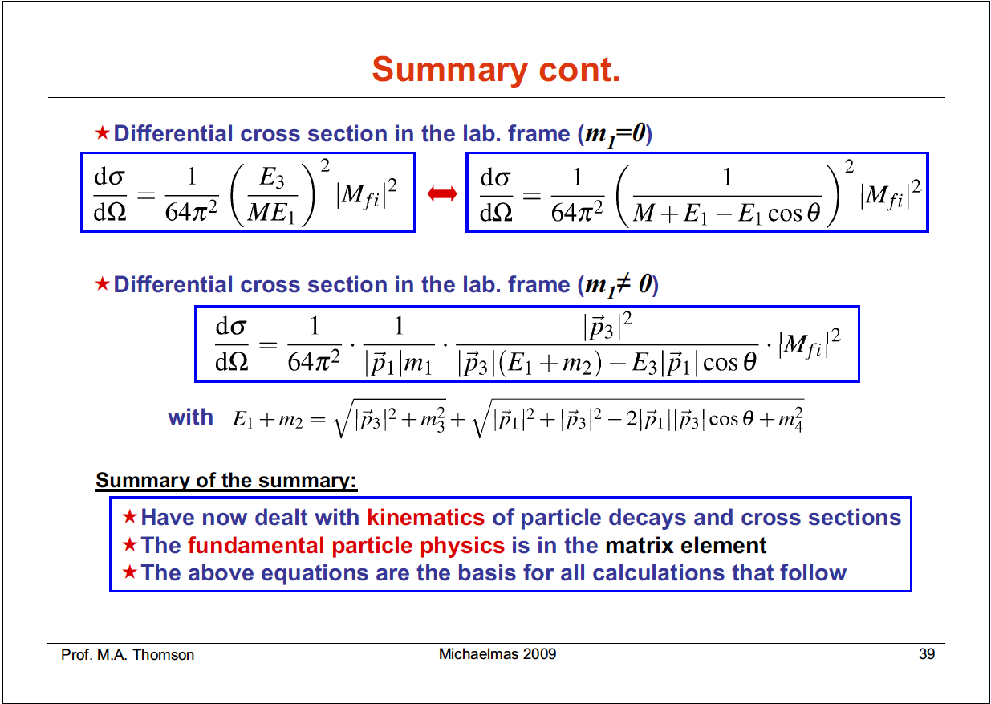

Slide 29
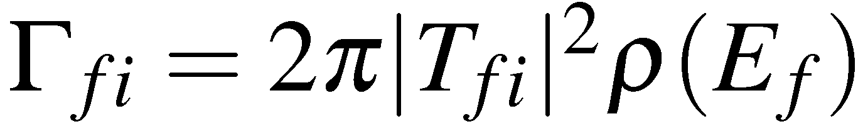
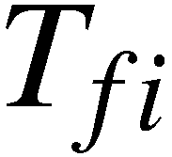
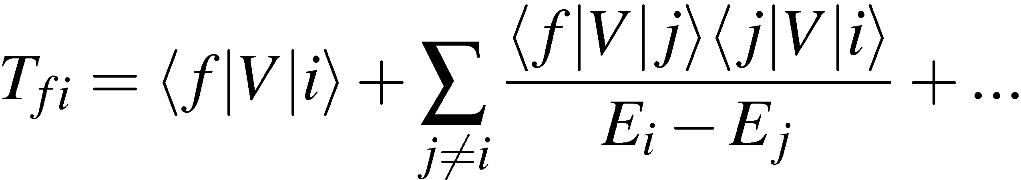
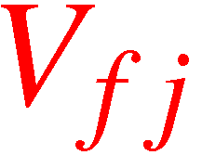


Interaction by Particle Exchange
Calculate transition rates from Fermi’s Golden Rule
where
is perturbation expansion for the Transition Matrix Element
For particle scattering, the first two terms in the perturbation series
can be viewed as:
f
f
“scattering in
a potential”
j
“scattering via an
intermediate state”
i
i
“Classical picture” – particles act as sources for fields which give
rise a potential in which other particles scatter – “action at a distance”
“Quantum Field Theory picture” – forces arise due to the exchange
of virtual particles. No action at a distance + forces between particles
now due to particles
Prof. M.A. Thomson
<número>

Slide 30
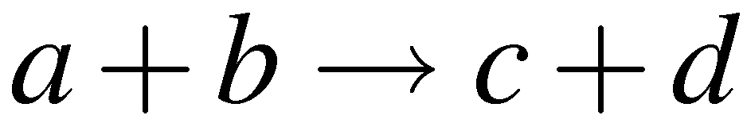
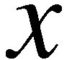
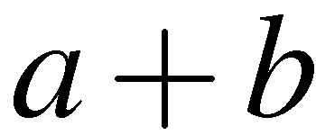
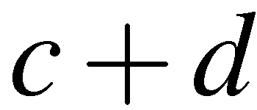
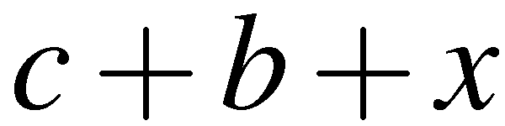
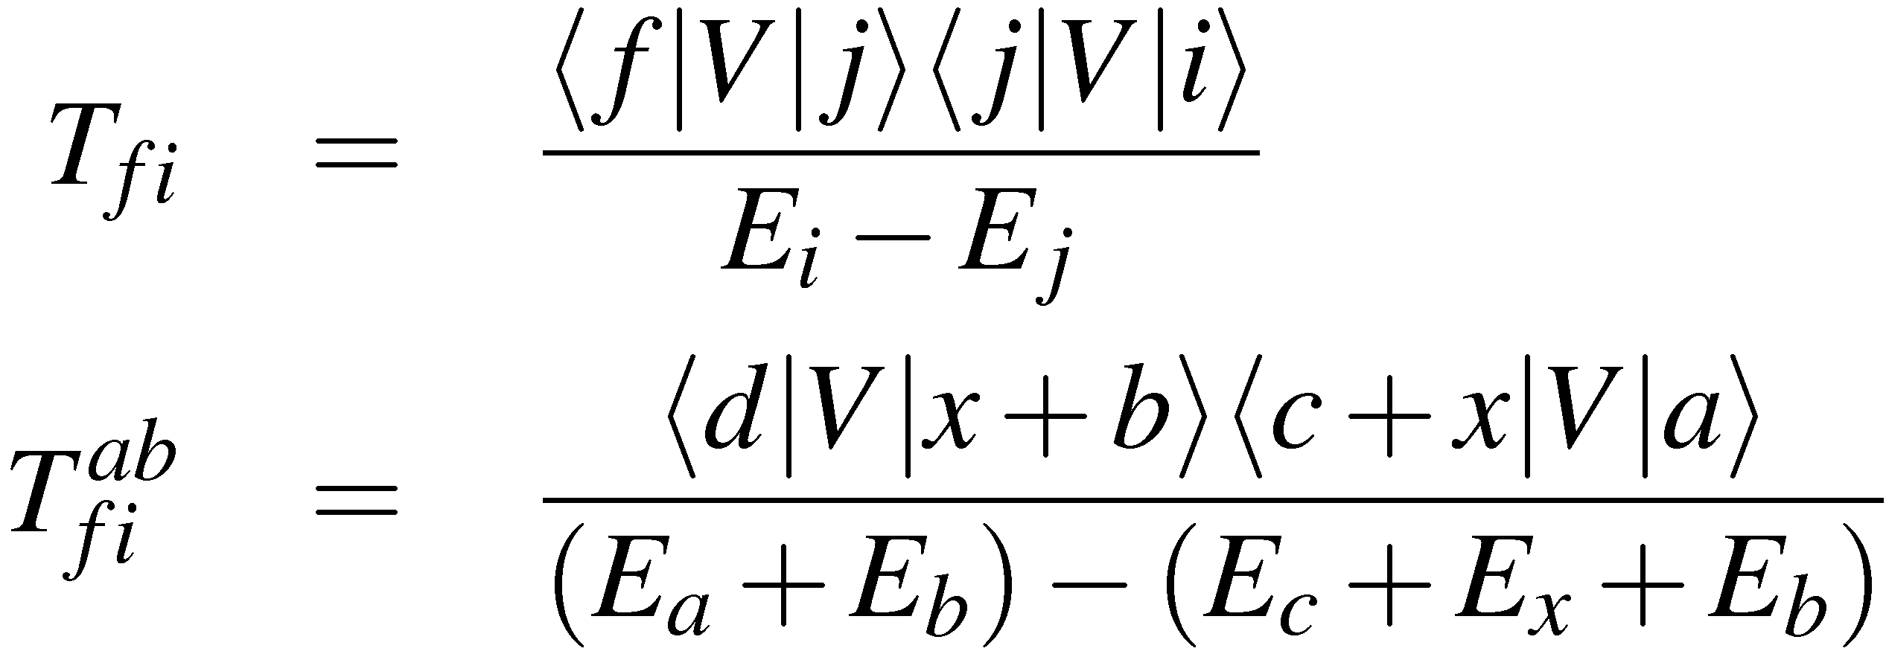

Consider the particle interaction which occurs
via an intermediate state corresponding to the exchange of particle
One possible space-time picture of this process is:
a
c
Initial state i :
space
V_{ji}
Final state f :
x
Intermediate state j :
V_{fj}
This time-ordered diagram corresponds to
a “emitting” x and then b “absorbing” x
b
d
i
j
f
time
The corresponding term in the perturbation expansion is:
refers to the time-ordering where a emits x before b absorbs it
Prof. M.A. Thomson
<número>

Slide 31
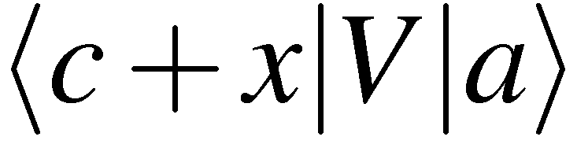
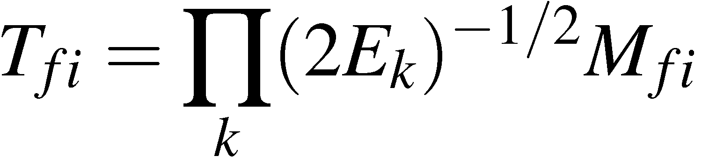
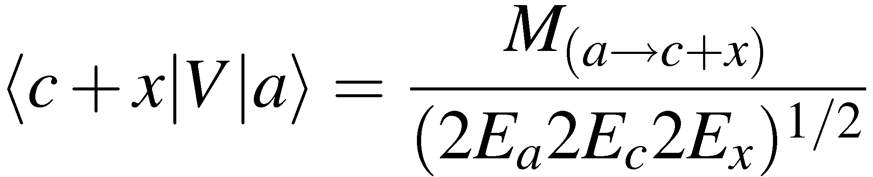
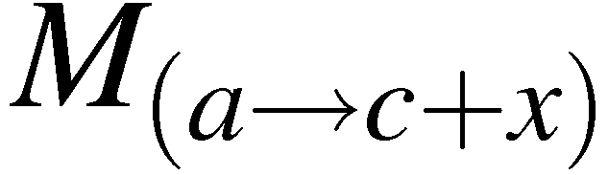
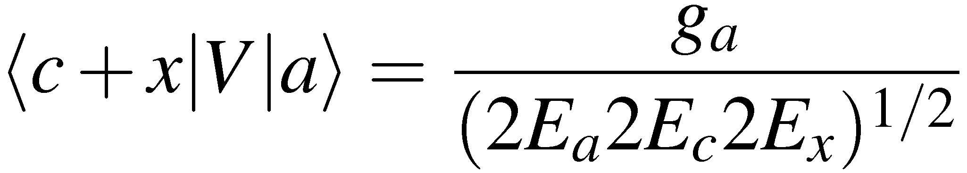
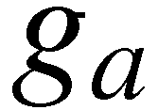
Need an expression for
in
a
c
g_{a}
non-invariant matrix element
Ultimately aiming to obtain Lorentz Invariant ME
x
Recall
is related to the invariant matrix element by
where k runs over all particles in the matrix element
Here we have
V_{ji}:
is the “Lorentz Invariant” matrix element for a  c + x
The simplest Lorentz Invariant quantity is a scalar, in this case
is a measure of the strength of the interaction a  c + x
Note : the matrix element is only LI in the sense that it is defined in terms of
LI wave-function normalisations and that the form of the coupling is LI
Note : in this “illustrative” example g is not dimensionless.
Prof. M.A. Thomson
<número>

Slide 32
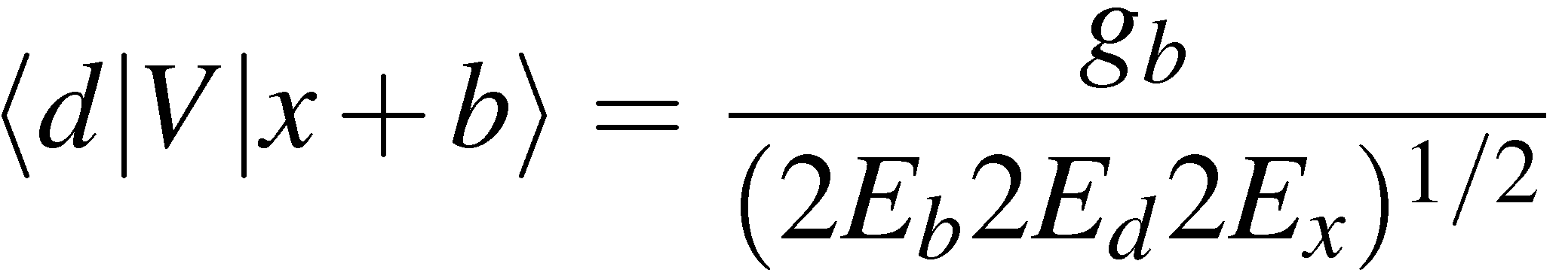
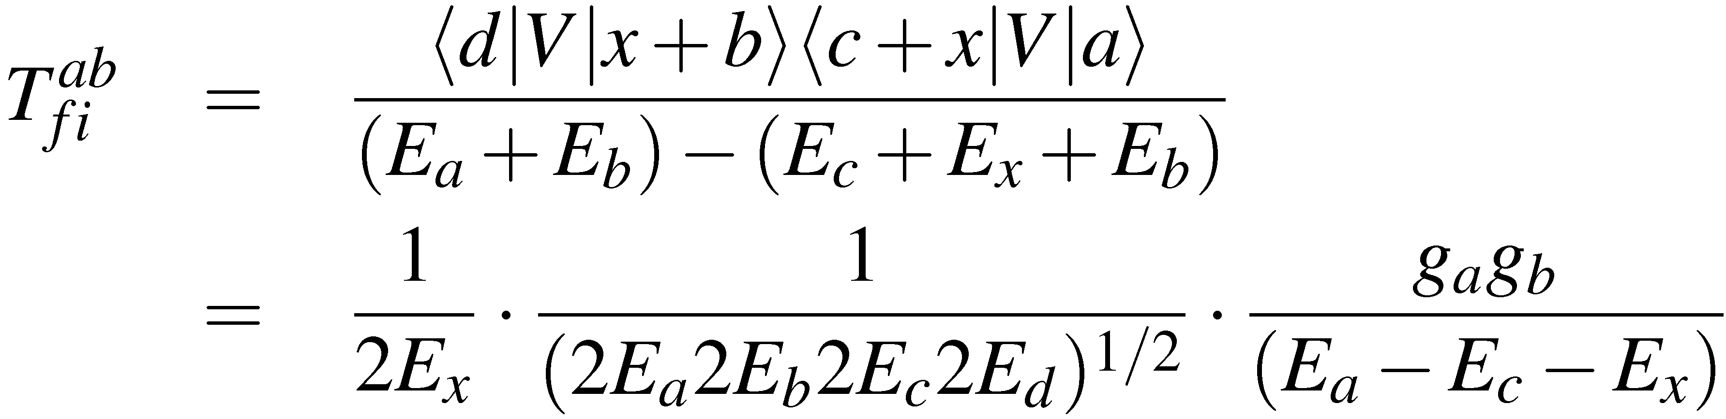
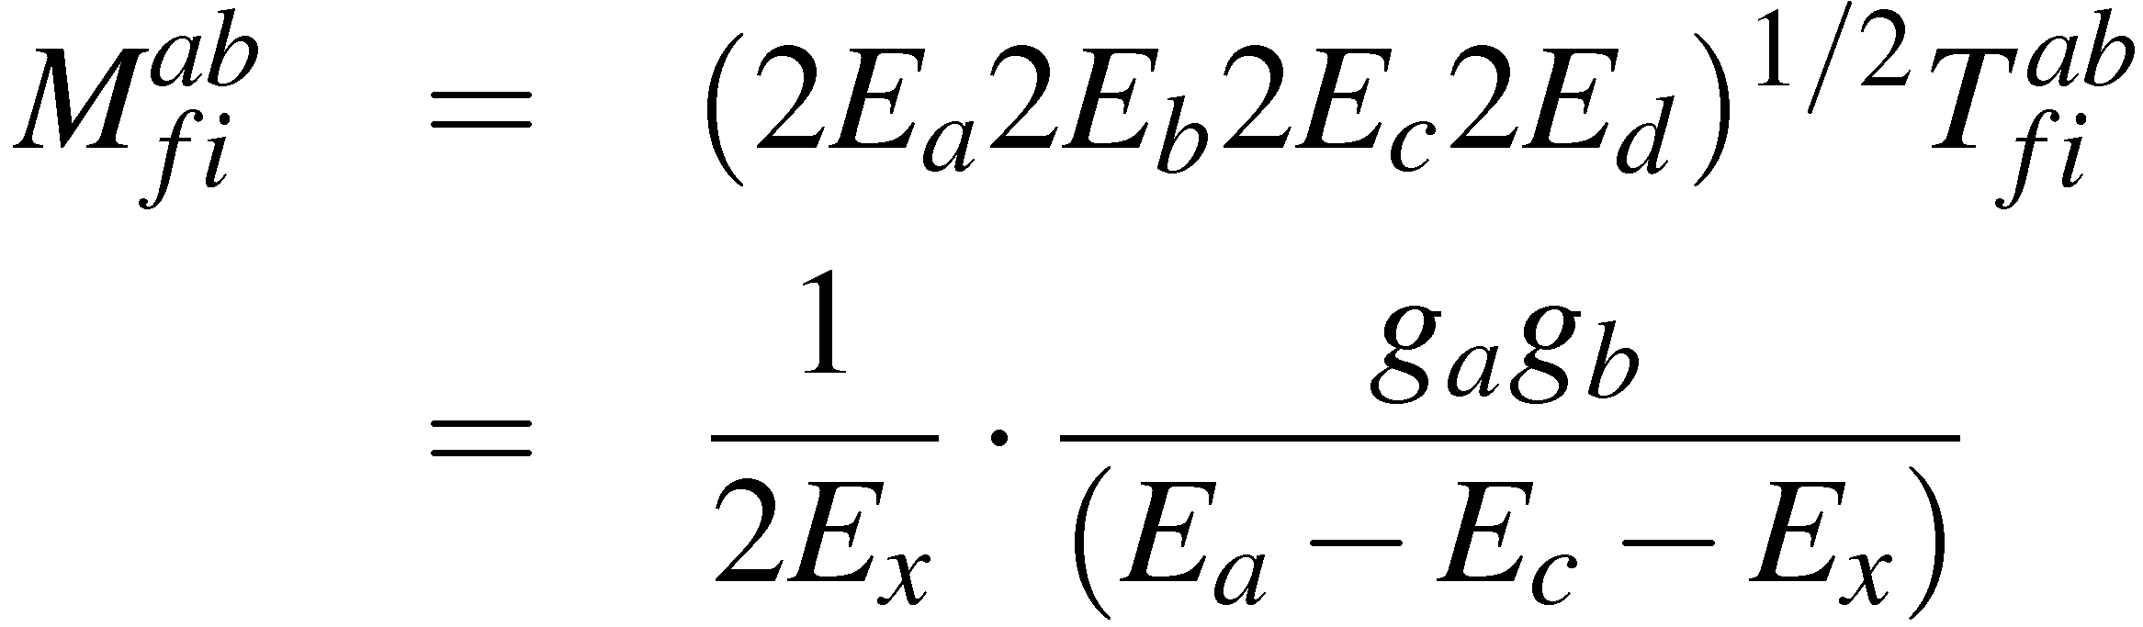

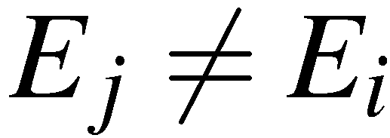
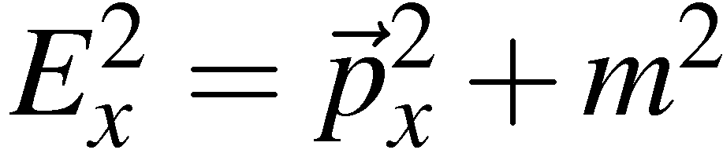
Similarly
x
b
g_{b}
d
Giving
The “Lorentz Invariant” matrix element for the entire process is
Note:
refers to the time-ordering where a emits x before b absorbs it
It is not Lorentz invariant, order of events in time depends on frame
Momentum is conserved at each interaction vertex but not energy
Particle x is “on-mass shell” i.e.
Prof. M.A. Thomson
<número>

Slide 33
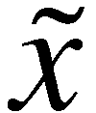
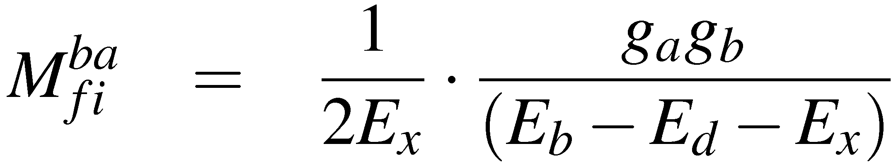
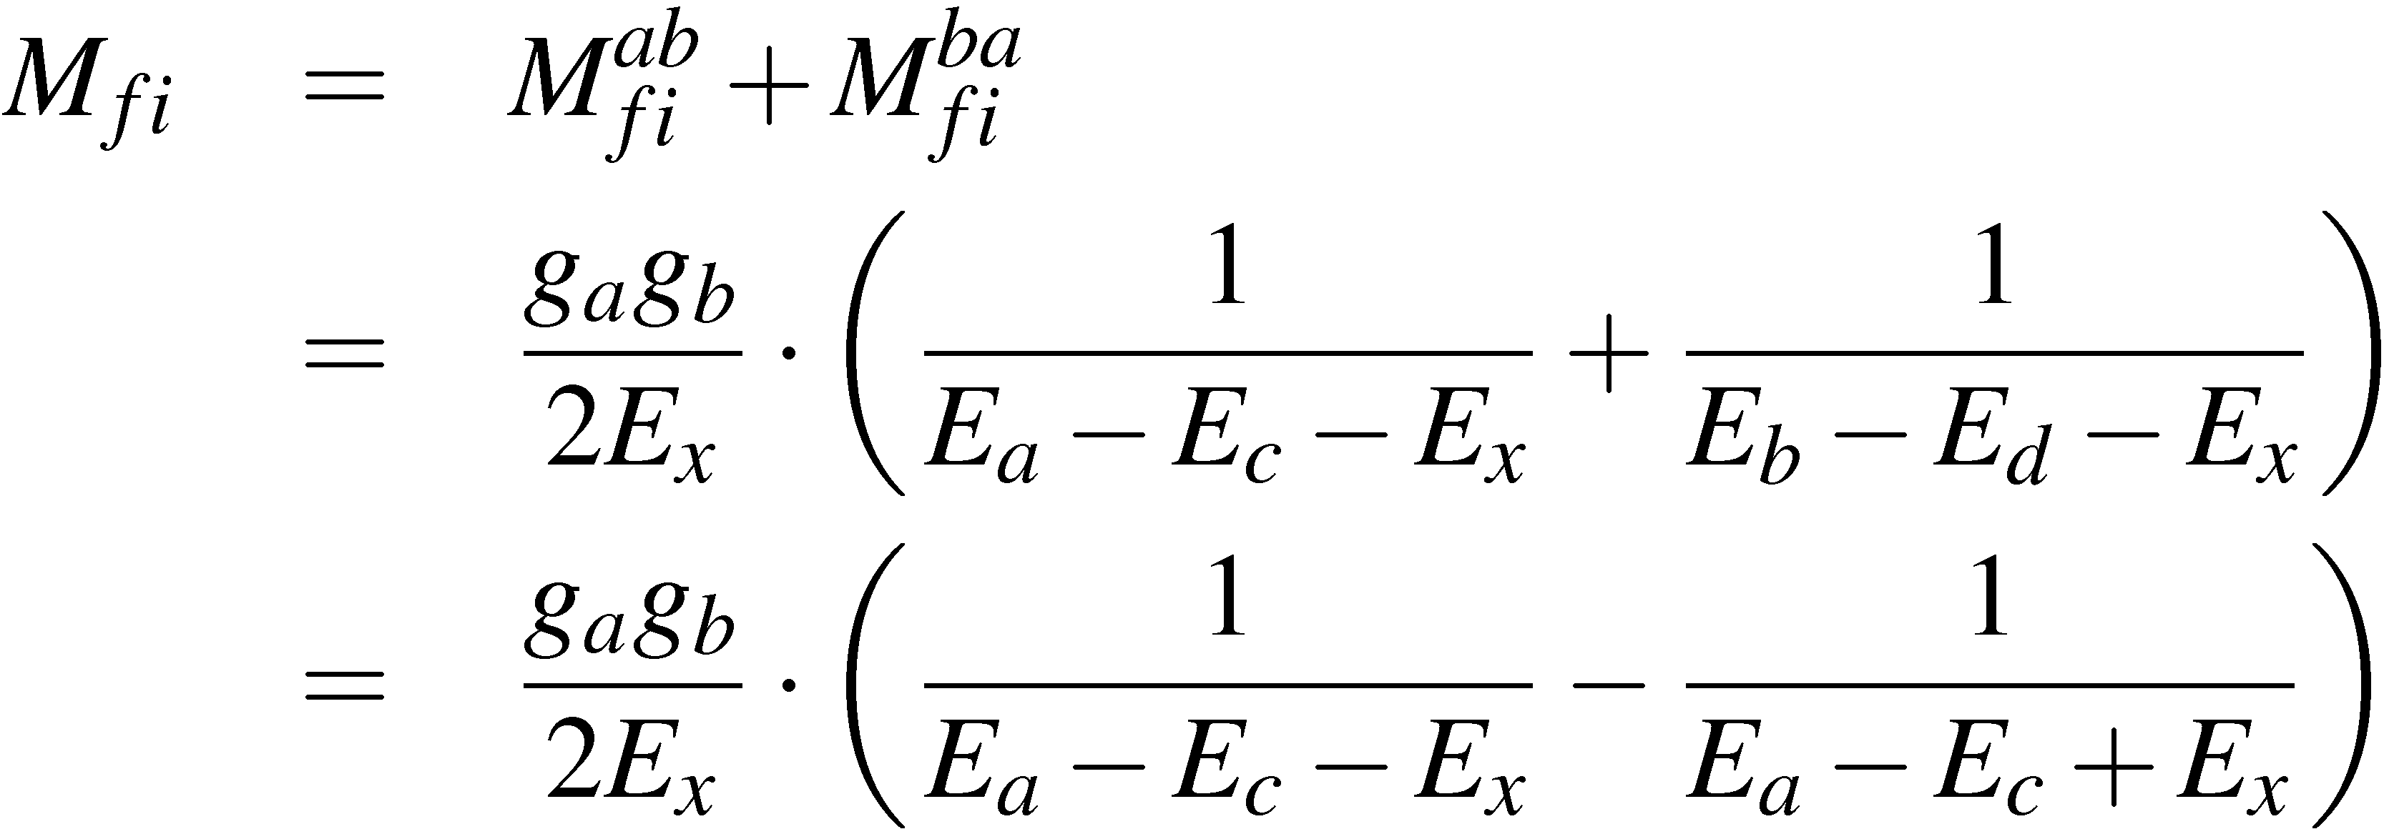

But need to consider also the other time ordering for the process
a
c
This time-ordered diagram corresponds to
b “emitting” x and then a absorbing x
space
~
~
~
x is the anti-particle of x e.g.
e–
ν_{e}
e–
ν_{e}
b
d
W–
W⁺
i
j
f
ν_{μ}
μ–
ν_{μ}
μ–
time
The Lorentz invariant matrix element for this time ordering is:
In QM need to sum over matrix elements corresponding to same final
state:
Energy conservation:
Prof. M.A. Thomson
<número>

Slide 34





Which gives
From 1st time ordering
a
c
giving
g_{a}
After summing over all possible time orderings, is (as anticipated)
Lorentz invariant. This is a remarkable result – the sum over all time
orderings gives a frame independent matrix element.
Exactly the same result would have been obtained by considering the
annihilation process
Prof. M.A. Thomson
<número>

Slide 35

Feynman Diagrams
The sum over all possible time-orderings is represented by a
FEYNMAN diagram
a
c
a
c
a
c
space
space
b
d
b
d
b
d
time
time
a
c
In a Feynman diagram:
the LHS represents the initial state
the RHS is the final state
everything in between is “how the interaction
happened”
b
d
It is important to remember that energy and momentum are conserved
at each interaction vertex in the diagram.
The factor is the propagator; it arises naturally from
the above discussion of interaction by particle exchange
Prof. M.A. Thomson
<número>

Slide 36










The matrix element:
depends on:
The fundamental strength of the interaction at the two vertices
The four-momentum, , carried by the (virtual) particle which is
determined from energy/momentum conservation at the vertices.
Note can be either positive or negative.
a
c
Here
“t-channel”
For elastic scattering:
[also q² = -4E₁E₂sin²(θ/2)]
b
d
q² < 0
termed “space-like”
(the sum of space components >
time components)
Here
“s-channel”
In CoM:
(the sum of time components >
space components)
q² > 0
termed “time-like”
Prof. M.A. Thomson
<número>

Slide 37



Virtual Particles
“Time-ordered QM”
Feynman diagram
a
c
a
c
a
c
space
space
b
d
b
d
b
d
time
time
Momentum conserved at vertices
Energy not conserved at vertices
Exchanged particle “on mass shell”
Momentum AND energy conserved
at interaction vertices
Exchanged particle “off mass shell”
VIRTUAL PARTICLE
Can think of observable “on mass shell” particles as propagating waves
and unobservable virtual particles as normal modes between the source
particles:
Prof. M.A. Thomson
<número>

Slide 38







Quantum Electrodynamics (QED)
Now consider the interaction of an electron and tau lepton by the exchange
of a photon. Although the general ideas we applied previously still hold,
we now have to account for the spin of the electron/tau-lepton and also
the spin (polarization) of the virtual photon.
(Non-examinable)
The basic interaction between a photon and a charged particle can be
introduced by making the minimal substitution (part II electrodynamics)
(here charge)
In QM:
Therefore make substitution:
where
The Dirac equation:
Prof. M.A. Thomson
<número>

Slide 39







Combined rest
mass + K.E.
Potential
energy
We can identify the potential energy of a charged spin-half particle
in an electromagnetic field as:
(note the A₀ term is
just: )
The final complication is that we have to account for the photon
polarization states.
e.g. for a real photon propagating in the z direction we have two
orthogonal transverse polarization states
Could equally have
chosen circularly
polarized states
Prof. M.A. Thomson
<número>

Slide 40





Previously with the example of a simple spin-less interaction we had:
a
c
=
=
g_{a}
g_{b}
b
d
e–
e–
In QED we could again go through the procedure
of summing the time-orderings using Dirac
spinors and the expression for . If we were
to do this, remembering to sum over all photon
polarizations, we would obtain:
τ–
τ–
Interaction of e–
with photon
Massless photon propagator
summing over polarizations
Interaction of τ–
with photon
All the physics of QED is in the above expression !
Prof. M.A. Thomson
<número>

Slide 41









The sum over the polarizations of the VIRTUAL photon has to include
longitudinal and scalar contributions, i.e. 4 polarisation states
and gives:
This is not obvious – for the
moment just take it on trust
and the invariant matrix element becomes:
(end of non-examinable
section)
Using the definition of the adjoint spinor
This is a remarkably simple expression ! It is shown in Appendix V
of Handout 2 that transforms as a four vector. Writing
showing that M is Lorentz Invariant
Prof. M.A. Thomson
<número>

Slide 42
Feynman Rules for QED
It should be remembered that the expression
hides a lot of complexity. We have summed over all possible time-
orderings and summed over all polarization states of the virtual
photon. If we are then presented with a new Feynman diagram
we don’t want to go through the full calculation again.
Fortunately this isn’t necessary – can just write down matrix element
using a set of simple rules
Basic Feynman Rules:
e⁺
μ⁺
Propagator factor for each internal line
γ
(i.e. each internal virtual particle)
Dirac Spinor for each external line
e–
μ–
(i.e. each real incoming or outgoing particle)
Vertex factor for each vertex
Prof. M.A. Thomson
<número>

Slide 43










Basic Rules for QED
External Lines
incoming particle
outgoing particle
spin 1/2
incoming antiparticle
outgoing antiparticle
incoming photon
spin 1
outgoing photon
Internal Lines (propagators)
μ
ν
spin 1 photon
spin 1/2 fermion
Vertex Factors
spin 1/2 fermion (charge -|e|)
Matrix Element = product of all factors
Prof. M.A. Thomson
<número>

Slide 44






e.g.
e–
e–
e–
e–
τ–
τ–
τ–
τ–
Which is the same expression as we obtained previously
e.g.
e⁺
μ⁺
γ
e–
μ–
Note:
At each vertex the adjoint spinor is written first
Each vertex has a different index
The of the propagator connects the indices at the vertices
Prof. M.A. Thomson
<número>

Slide 45

Summary
Interaction by particle exchange naturally gives rise to Lorentz Invariant
Matrix Element of the form
Derived the basic interaction in QED taking into account the spins
of the fermions and polarization of the virtual photons:
We now have all the elements to perform proper calculations in QED !
Prof. M.A. Thomson
<número>

Slide 46


Slide 47


Slide 48


Slide 49


